Slide 1
Extra
Sums of Squares
When we wish to test whether a predictor variable X_{k} has a linear effect on Y, we test
H_{o}: β_{k} = 0 vs H_{a}: β_{k} ≠ 0
We already know that using a t-test is appropriate for this test.
Equivalently, we can use the general linear test approach, which we will see involves an extra sum of squares.
We will consider a regression model with three predictors.

Slide 2

Extra
Sums of Squares
To test H_{o}: β₃ = 0 vs H_{a}: β₃ ≠ 0, we fit the full model and obtain the error sum of squares SSE(F), where
SSE(F) = SSE(X₁,X₂,X₃)
SSE(F) has n-4 degrees of freedom since there are four Betas in the full model.
The reduced model under the null is simply
Next, we fit the reduced model and obtain
SSE(R) = SSE(X₁,X₂)

Slide 3
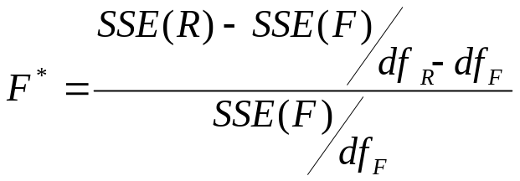
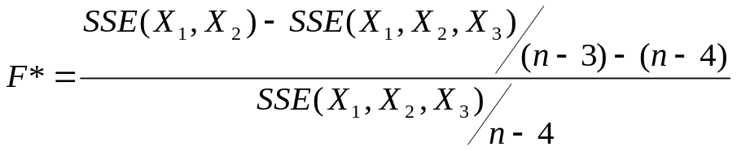
Extra
Sums of Squares
The reduced model has n-3 degrees of freedom since now there are only 3 Betas in the model.
The general linear test statistic is
which here is

Slide 4
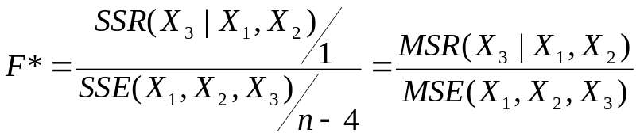
Extra
Sums of Squares
Note that the difference between the two error sums of squares in the numerator is the extra sums of squares for adding X₃ given X₁ and X₂ are already in the model.
SSE(X₁,X₂) – SSE(X₁,X₂,X₃) = SSR(X₃|X₁,X₂)
Therefore the general linear test statistic can be written as
So to test whether or not β₃ = 0 is a marginal test, given that X₁ and X₂ are already in the model.

Slide 5
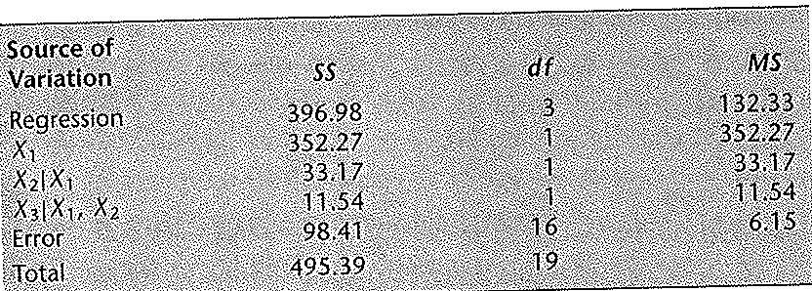
Extra
Sums of Squares
We can see from this version of the test statistic, that we do not need to run both the full model and the reduced model, simply just the full model.
For the body fat example (where we have three predictors), we wish to test whether midarm circumference which is denoted by X₃ can be dropped from the model.
The below table contains the ANOVA results for fitting the full model.

Slide 6
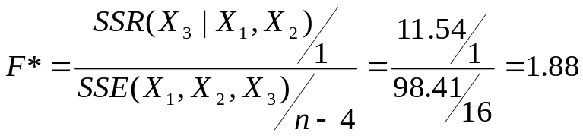
Extra
Sums of Squares
The test statistic is then
where SSE(X₁,X₂,X₃) is the error sum of squares for the whole model
The null hypothesis is the reduced model is sufficient. So if our test statistic is significant, we conclude we can not use the reduced model.
If the test statistic is not significant, we conclude the reduced model holds.

Slide 7
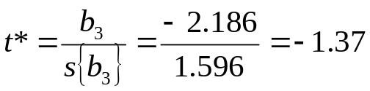
Extra
Sums of Squares
For α=.05, we require our F statistic to be greater than F(.95;1,16), which is about 4.5. Since our F statistic is only 1.88, we fail to reject and conclude that the reduced model holds.
To test H_{o}: β₃ = 0 vs H_{a}: β₃ ≠ 0 using a t test, we use
where the estimate b₃ and its standard error come from running the full model
Since (t*)² = (-1.37)² = 1.88 = F*, we see the two test statistics are equivalent.

Slide 8
Extra
Sums of Squares
The F* statistic to test whether or not β₃ = 0 is called the partial F test statistic.
The F* statistic we saw earlier to test whether all the β_{k} = 0, that is to test whether or not there is a regression relation between Y and any predictor variable, is called the overall F test statistic.
We may wish to test whether some, but not all, of the predictor terms can be dropped from the model.
For instance, we may want to test
H_{o}: β₂ = β₃ = 0 vs H_{a}: not both β₂ and β₃ = 0

Slide 9

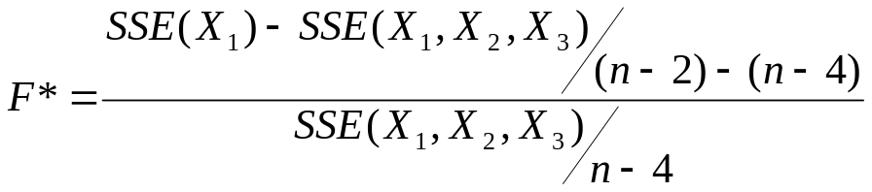
Extra
Sums of Squares
With the general linear test approach, the reduced model under the null is
The error sums of squares for the reduced model is SSE(R) = SSE(X₁), which has n-2 degrees of freedom.
The general linear test statistic becomes

Slide 10

Extra
Sums of Squares
Again, the two error sums of squares in the numerator is an extra sums of squares, the extra sums of squares for adding X₂ and X₃ given X₁ is already in the model.
SSE(X₁) – SSE(X₁,X₂,X₃) = SSR(X₂,X₃|X₁)
So the test statistic becomes

Slide 11
Extra
Sums of Squares
We wish to test in the body fat example (which has three predictors) whether both thigh circumference (X₂) and midarm circumference (X₃) can be dropped from the model.
This is testing
H_{o}: β₂ = β₃ = 0 vs H_{a}: not both β₂ and β₃ = 0
To solve for SSR(X₂,X₃|X₁), we can use the equality (shown earlier)
SSR(X₂,X₃|X₁) = SSR(X₂|X₁) + SSR(X₃|X₁,X₂)
From the ANOVA table, we have SSR(X₂,X₃|X₁) =33.17 + 11.54 = 44.71

Slide 12
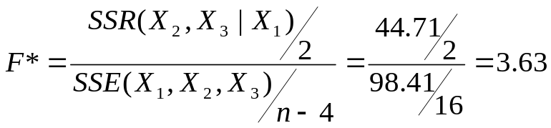
Extra
Sums of Squares
The test statistic is then
For α = .05, we require that F(.95;2,16) = 3.63. Since F* = 3.63 is at the boundary, we may wish to do further analysis before dropping X₂ and X₃ from the model.
For testing whether a single β_{k} equals zero, there are two equivalent tests: the t test and the general linear F test.
When testing whether several β_{k} equal zero, only the general linear F test is available.

Slide 13
Extra
Sums of Squares
When tests about regression coefficients are desired that do not involve testing whether one or several β_{k} equal zero, extra sums of squares can not be used.
We use the general linear test approach by separately fitting the full model and the reduced model.
For instance, for the full model with three predictor variables, we may wish to test
H_{o}: β₁ = β₂ vs H_{a}: β₁ ≠ β₂
We would fit the full model and then the reduced model.

Slide 14

Extra
Sums of Squares
The reduced model is
where β_{c} denotes the common coefficient for β₁and β₂ under the null.
Note df_{R} equals n-3 since there are 3 Betas and df_{F} equals n-4 since there are 4 Betas. Thus df_{R} - df_{F} = 1.
Thus the general F* test statistic we use has 1 and n-4 degrees of freedom.

Slide 15
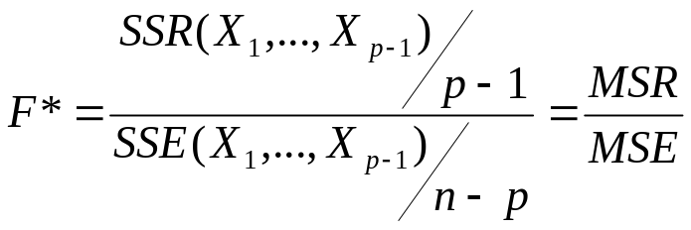
Summary of Tests
We have discussed 4 types of F tests. The first, was the overall F test, which tests all the Betas (except β₀) equal 0.
H_{o}: β₁ = β₂ = … = β_{p-1} = 0 vs H_{a}: At least one β_{k} ≠ 0
This is used to test if the model has any effect on the mean response Y. The test statistic is
When the null is true, the statistic F* = MSR/MSE follows an F distribution with p-1 and n-p degrees of freedom.

Slide 16
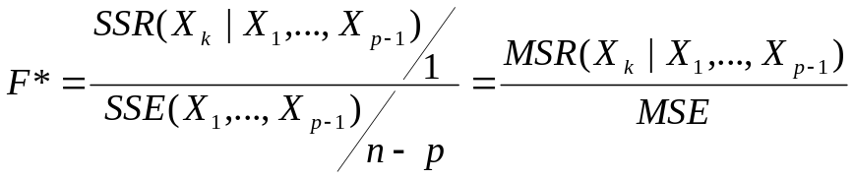
Summary of Tests
We also used a partial F test to test whether a particular regression coefficient β_{k} equals 0. We test
H_{o}: β_{k} = 0 vs H_{a}: β_{k} ≠ 0
The test statistic is
When the null is true, the statistic F* follows an F distribution with 1 and n-p degrees of freedom.

Slide 17
Summary of Tests
Another partial F statistic is used to test if some of the β_{k} equal 0. We will write this test as
H_{o}: β_{q}= β_{q+1} = … = β_{p-1} =0 vs H_{a}: not all the β_{k} in H_{o} equal 0
Note, the last p-q coefficients are the ones to be tested. This means there are q β coefficients in the reduced model (including β_{o}).
For example, suppose we have a model with 7 predictors, thus p-1=7, and we have a total of p=8 β coefficients. If we want to test whether 3 are 0, we will have q=5 β coefficients left (including β₀). Note, p-q = 8-5 =3 and we arrange it so these 3 β coefficients to be tested are last and the null is
H_{o}: β₅= β₆= β₇ = 0

Slide 18
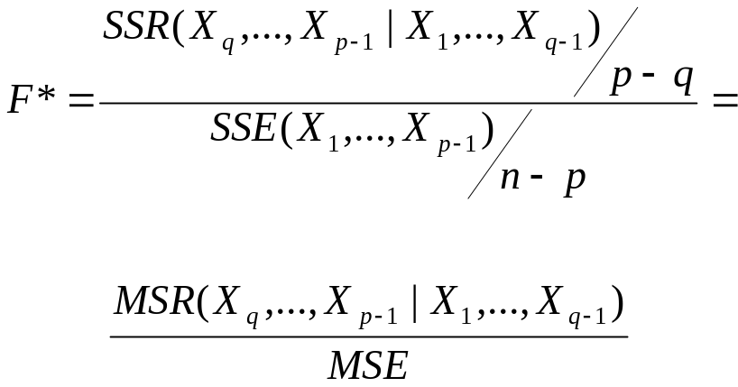
Summary of Tests
The full model has β₀ to β₇ (8 parameters) and the reduced model has β₀ to β₄ (5 parameters). The F statistic used is
When the null is true, the statistic F* follows an F distribution with p-q and n-p degrees of freedom. Note, p-q is the number of Betas being tested or the difference in the number of Betas between the full and reduced models.

Slide 19
Summary of Tests
Note, this test statistic encompasses the two earlier cases. We test the p-q Betas. If q=1, then p-q=p-1 and we are testing all the predictor Betas (just the intercept is left out). The test is whether all regression coefficients equal 0. (Overall F test)
If q=p-1 then p-q=p-(p-1) = 1 and we are testing just one Beta. The test is whether a single regression coefficient equals 0.
Also, the test statistic can be calculated without fitting the reduced model by using extra sums of squares.
SSR(X_{q},…,X_{p-1} |X₁ ,…,X_{q-1}) =
SSR(X_{q}| X₁ ,…,X_{q-1}) + SSR(X_{q+1}| X₁ ,…,X_{q-1} ,X_{q})+ …+ SSR(X_{p-1}|X₁,…,X_{p-2})

Slide 20
Summary of Tests
When we want to test if regression coefficients equal a value besides zero, extra sums of squares can not be used.
We must use a general linear test approach and fit both the full and reduced models.
Consider a full model with three predictors
we may wish to test
H_{o}: β₁ = β₂ vs H_{a}: β₁ ≠ β₂

Slide 21


Summary of Tests
We fit the full model and the reduced model, which is
where β_{c} denotes the common coefficient for β₁and β₂ under the null.
We then use the general F statistic
The df_{f} are n-4 and the df_{r} are n-3. Thus, when the null is true, the statistic F* follows an F distribution with 1 an dn-4 degrees of freedom.
SAS - FTESTS

Slide 22

Coefficients of
Partial Determination
Recall that the coefficient of multiple determination, R², measures the proportion of the variation in Y explained by the introduction of all the predictor variables in the model.
Equivalently, R², measures the proportionate reduction in the variation of Y by the introduction of all the predictor variables in the model.
A coefficient of partial determination measures the marginal contribution of one predictor variable when all the others are already included.
We first consider the case with two predictor variables.

Slide 23
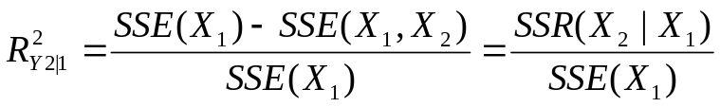
Coefficients of
Partial Determination
SSE(X₁) measures the unexplained variation in Y when X₁ is included in the model and SSE(X₁, X₂) measures the unexplained variation in Y when both X₁ and X₂ are included in the model
Therefore the relative marginal reduction in the unexplained variation in Y associated with X₂ when X₁ is already in the model, denoted by, R²_{y2|1}, is
This measure is the coefficient of partial determination between Y and X₂, given that X₁ is in the model.

Slide 24
Coefficients of
Partial Determination
After X₁ is included in the model, there is still unexplained variation in Y, measured by SSE(X₁).
When X₂ is included in this model that already has X₁, this unexplained variation in Y decreases.
R²_{y2|1} measures the proportion of unexplained variation with X₁ in the model, namely SSE(X₁), that is then explained by adding X₂.
Equivalently, R²_{y1|2} measures the proportion of unexplained variation with X₂ in the model, namely SSE(X₂), that is then explained by adding X₁.

Slide 25
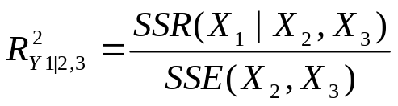
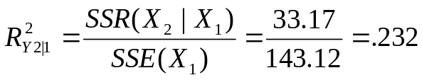
Coefficients of
Partial Determination
The generalization of coefficients of partial determination to three or more X variables in the model is straight forward.
For instance R²_{Y 1|2,3} , the coefficient of partial determination between Y and X₁, given that X₂ and X₃ are in the model, is
For the body fat example, we can obtain a variety of coefficients of partial determination. For instance,

Slide 26
Coefficients of
Partial Determination
Thus, when X₂ is added to the model already containing X₁, the error sums of squares SSE(X₁) is reduced by 23.2%.
The square root of a coefficient of partial determination is called a coefficient of partial correlation.
It is given the same sign as that of the corresponding β in the fitted regression function.
Coefficient of partial correlations are often used for finding the best predictor variable to be selected next for inclusion in a regression model (which we will discuss later).

